Slide 1


Netflix Analysis Project
By:
Niket Talikoti

Slide 2

Project Summary
This project aims to analyze and cluster Netflix's vast content library using data science techniques, focusing on TV shows and movies available on the platform. The dataset includes rich metadata such as title, type, genre, release year, country, rating, and description. Through exploratory data analysis (EDA) and clustering, the goal is to uncover hidden patterns and trends that can help Netflix better understand its content distribution, genre popularity, and regional preferences.

Slide 3
Problem Statement
With thousands of titles available, Netflix faces the challenge of efficiently organizing and recommending content to a global audience. The diversity of genres, inconsistent metadata, and the growing volume of international content make it essential to identify meaningful groupings within the content library for improved curation and personalized recommendations.

Slide 4
Business Objective
The objective is to use clustering (K-Means) and dimensionality reduction (PCA) to segment content based on genres and other features. These clusters can inform Netflix's content strategy, improve recommendation systems, and identify gaps or oversaturation in certain categories.

Slide 5
General Guidelines
Use Python, Pandas, and Plotly for data analysis and visualization.
Perform data cleaning and transformation.
Apply TF-IDF vectorization on genres.
Visualize clusters using PCA and Plotly for business insights.

Slide 6

Exploratory Data Analysis (EDA)

Slide 7
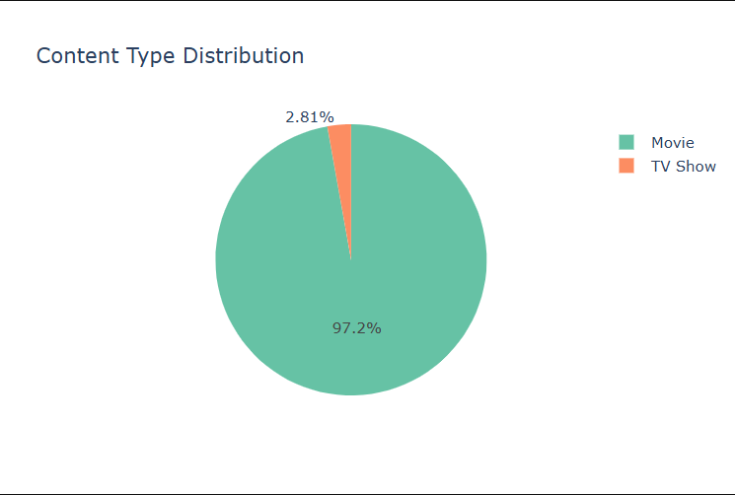
Content Type Distribution
Content Split: Netflix content is heavily Movie-dominated (97.2%) vs. a tiny fraction of TV Shows (2.8%).
Interpretation: This suggests either a strong focus on movies or indicates skewed/incomplete data.
Implication: If the focus is real, adding more TV shows could boost engagement. If the data is bad, fix it for accurate analysis.

Slide 8
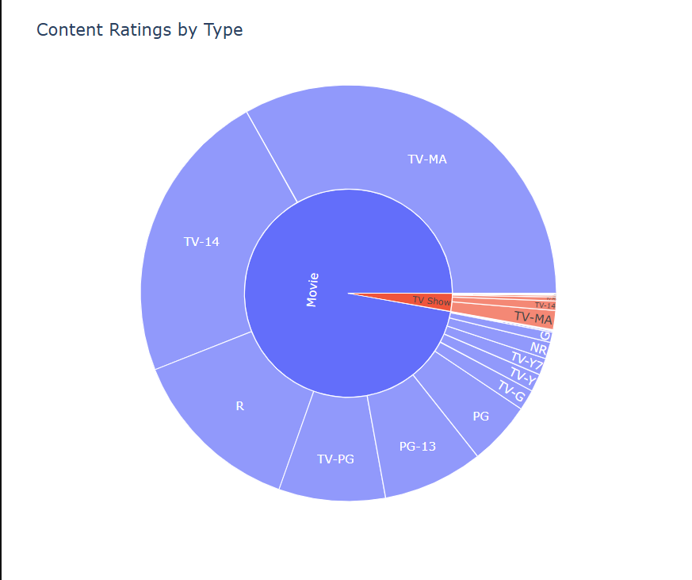
Content Ratings by Type
Chart Focus: Visualizes content ratings distribution across Movies and TV Shows.
Movie Ratings: Movies dominate content, with the most common ratings being TV-MA, TV-14, and R (mature/adult/teen focused).
TV Show Ratings: TV Shows are a small portion, but are also primarily rated TV-MA and TV-14.
Family Content: Ratings like TV-G, TV-Y, G are minimally represented.
Audience Skew: Content primarily targets adult and teen audiences, less so younger viewers/families.
Business Action: Suggests potentially expanding content in underrepresented (family-friendly) rating categories to broaden appeal.

Slide 9
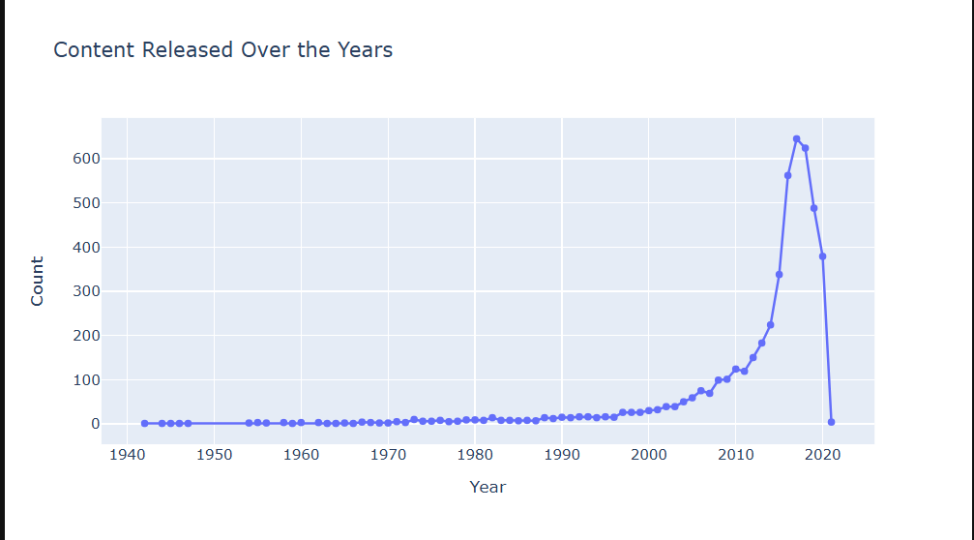
Content Released Over the Years
The chart shows minimal Netflix titles before 2010, followed by a steep content boom peaking 2018-2019, then a sharp drop after 2020 (likely due to data issues for recent years).
The content surge reflects Netflix's aggressive expansion strategy, while the recent decline may be linked to factors like COVID-19 or data lags.
Evaluating if the post-2020 drop is real or data-related is crucial for future production planning based on these trends.

Slide 10
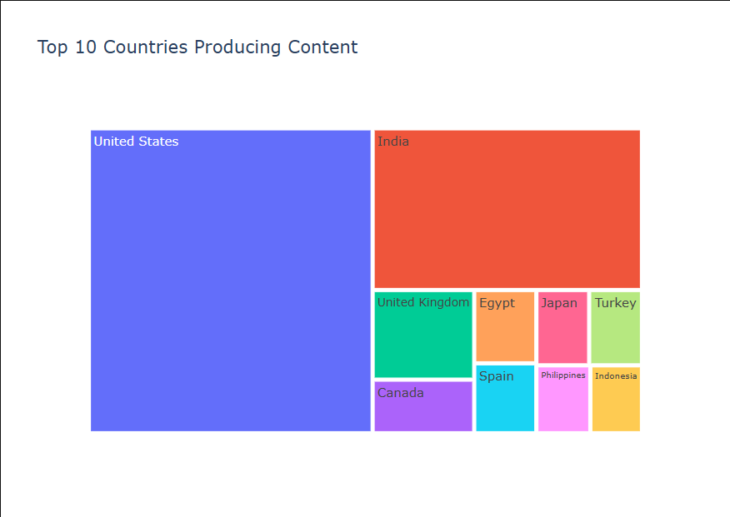
Top 10 Countries Producing Content
The treemap shows the United States overwhelmingly dominates Netflix content production, followed by India as the distant second.
The remaining top countries (including UK, Canada, Egypt, Japan, Turkey, Spain, Philippines, Indonesia) highlight Netflix's investment in diverse international markets, particularly outside traditional Western hubs.
This distribution points to Netflix's strategy of leveraging US production while increasingly focusing on local content globally to drive international audience growth and guide localization efforts.

Slide 11
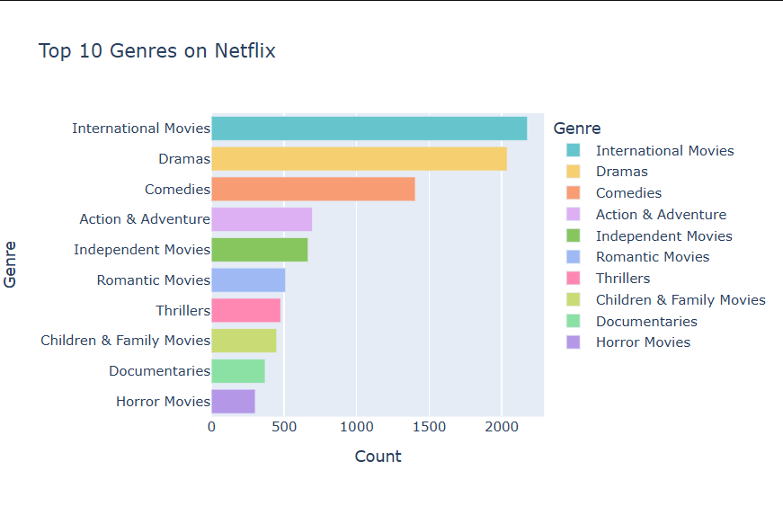
Top 10 Genres on Netflix
The chart shows International Movies are the most prevalent genre, followed closely by Dramas and Comedies, indicating a mix of global focus and universal appeal among top genres.
Other popular genres include Action, Independent, Romance, Thriller, Children & Family, Documentaries, and Horror, highlighting a diverse catalog catering to varied audience tastes.
The prominence of International Movies aligns with Netflix's global strategy, and the genre data helps inform content investment to serve diverse viewer segments and potentially expand in certain areas.

Slide 12
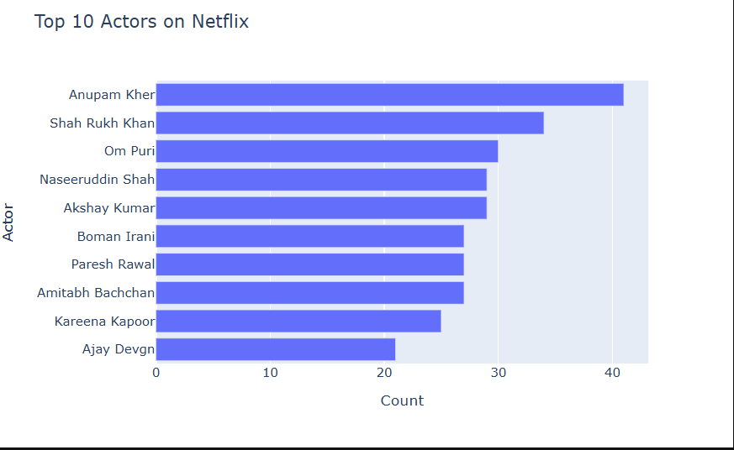
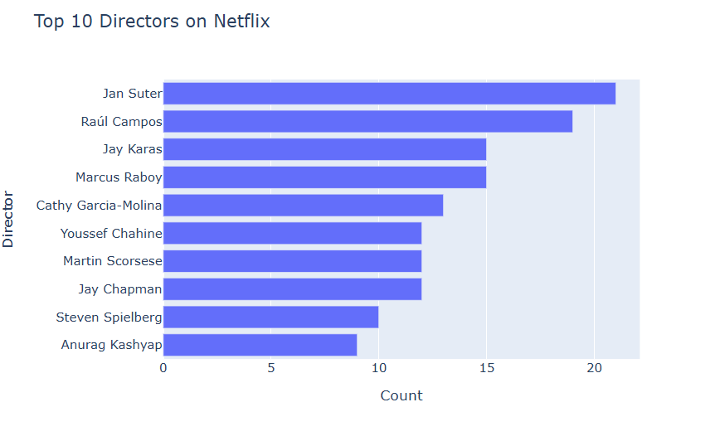
Top 10 Actors and Directors on Netflix
Actor Trends: The list is dominated by veteran Indian actors like Anupam Kher (most appearances), Shah Rukh Khan, Om Puri, and Akshay Kumar, indicating a strong focus on Indian cinema, though there is a notable gender imbalance among top actors.
Director Trends: Leading directors like Jan Suter and Raúl Campos point to significant Latin American content, alongside a global mix including filmmakers from the USA, India, and the Philippines, reflecting diverse international storytelling and genre representation.
Key Takeaway: Netflix strategically balances a heavy emphasis on localized Indian content (shown through actors) with a broad range of global storytelling (seen through directors), broadening its appeal across different regions and audience tastes.

Slide 13
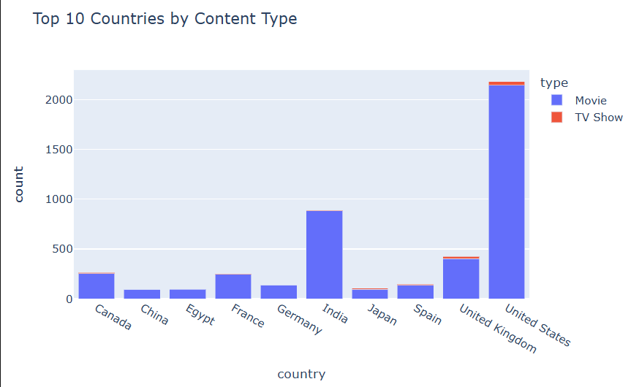
Top 10 Countries by Content Type
Content Hubs & Formats: Netflix is heavily dominated by movies, with the United States as the largest content producer, followed by India. Veteran Indian actors are prominent, reflecting a strong focus on Indian cinema (mostly films), and highlighting a movie-centric catalog overall.
Global Storytelling: The top directors include figures from Latin America and a diverse international mix, indicating a strategy to produce varied content across different regions and genres.
Strategic Balance & Opportunity: Netflix balances its core US/Indian movie focus with global localization efforts; there's potential to expand TV show production, particularly from non-Western markets like India, to further diversify offerings.

Slide 14
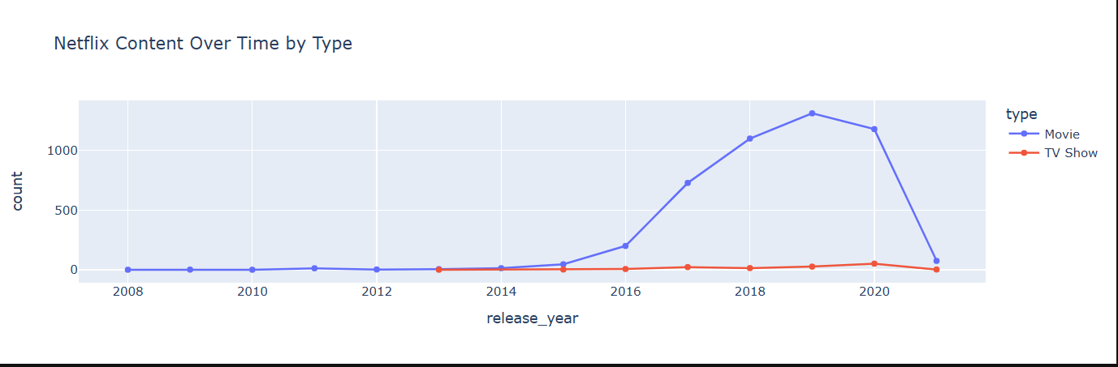
Netflix Content Over Time by Type
Netflix's catalog is heavily focused on movies, dominated by content from the United States and India. The top actors featured are predominantly veteran Indian males, reflecting a strong emphasis on Bollywood and Indian cinema.
The list of top directors is more diverse, including notable figures from Latin America and a global mix of prestigious names, indicating a strategic blend of regional appeal and international storytelling across genres.
Content volume saw a significant boom from 2016-2019 (aligning with global expansion), followed by a decline post-2020 (likely due to pandemic disruptions).
Overall, the analysis highlights a movie-centric, US- and India-heavy catalog with potential opportunities for increasing gender diversity among featured talent and investing more in original TV shows, particularly from non-U.S. markets.

Slide 15
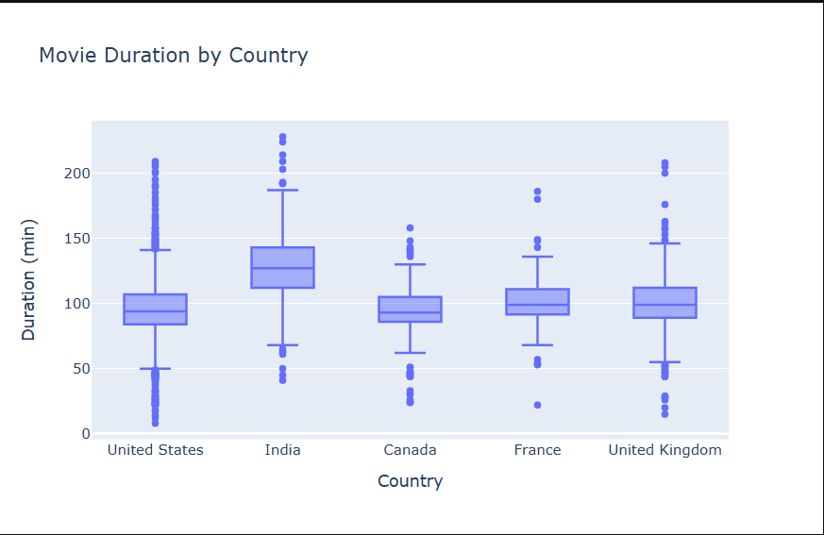
Movie Duration by Country
Netflix's catalog is heavily movie-centric, led overwhelmingly by the United States, followed by India. This is reflected in top actors being predominantly veteran Indian males, and India showing uniquely longer movie durations.
The platform features a diverse set of top directors, including those prominent in Latin American content and globally recognized names, indicating a strategy focused on broad international storytelling and genre diversity.
Content saw a significant boom during 2016-2019 linked to expansion, followed by a decline post-2020 (likely pandemic-related). Key opportunities include improving gender balance and investing more in original TV series, especially from non-U.S. markets.

Slide 16
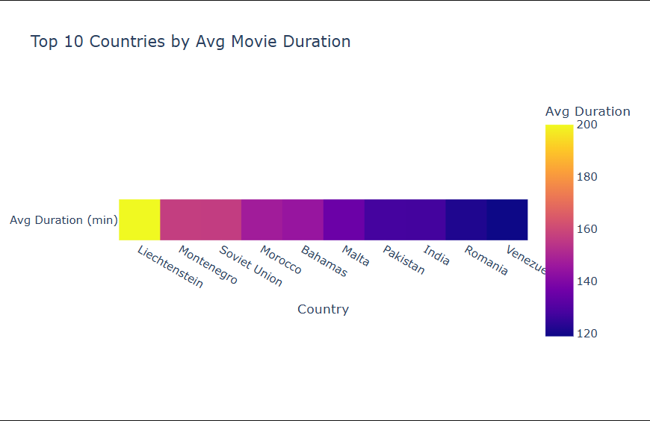
Top 10 Countries by Avg Movie Duration
Netflix's catalog is heavily centered around movies, primarily sourced from the United States and India. This is evident in the prominence and gender skew towards veteran Indian male actors, and India's unique trend of producing significantly longer films on average.
Top directors showcase greater global diversity, including leaders in Latin American content and internationally renowned filmmakers, reflecting Netflix's strategy of balancing regional appeal with global storytelling across various genres.
Content production saw a large increase from 2016-2019, coinciding with global expansion, followed by a drop after 2020, likely due to pandemic impacts. This reinforces the past movie-first expansion strategy, while highlighting ongoing opportunities to improve gender representation and grow international TV show offerings.

Slide 17

Clustering

Slide 18
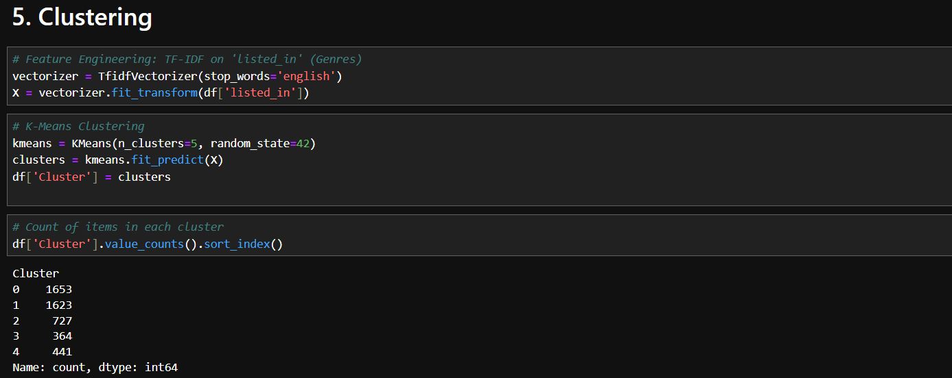
Clustering
Using TF-IDF on genre tags and K-Means clustering (k=5), Netflix content was grouped into 5 distinct clusters based on genre similarity.
The resulting cluster distribution shows two large clusters (0 and 1), likely representing broad/popular genre categories, and three smaller clusters (2, 3, and 4), potentially representing more niche content types.
This clustering demonstrates that Netflix content genres can be meaningfully grouped, providing a basis for further analysis to identify the dominant genres within each cluster.

Slide 19
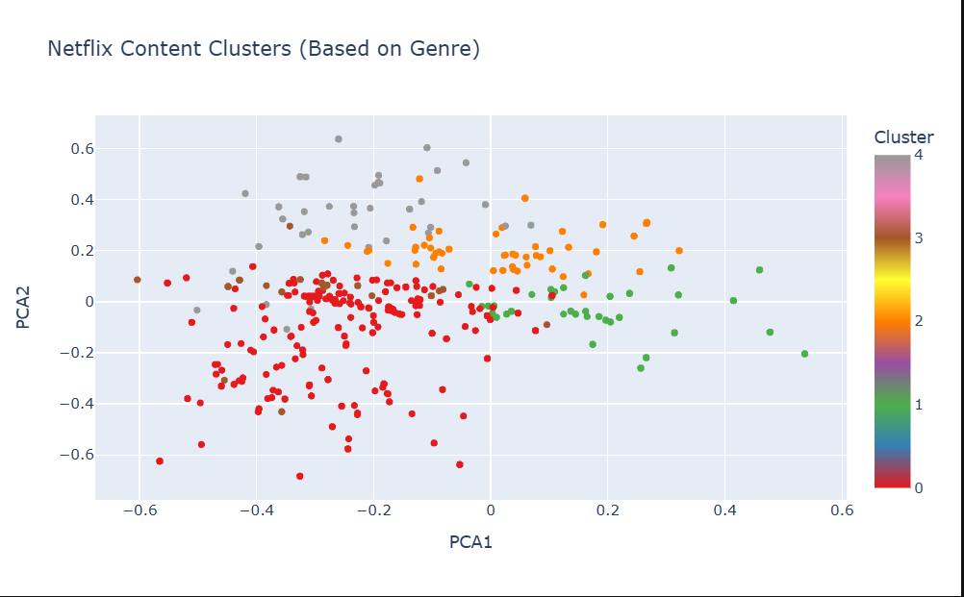
Visualizing Clusters using PCA
Netflix's catalog is heavily dominated by movies, with the United States and India being the top content-producing countries. Veteran Indian male actors are notably prominent, and Indian films tend to have longer durations than those from most other regions.
Top directors show greater international diversity, featuring leaders in Latin American content and globally recognized names, reflecting Netflix's strategy to produce a blend of regional and international content across genres.
Content volume saw a significant boom between 2016 and 2019, followed by a decline post-2020 (likely due to pandemic impacts). Clustering analysis confirms the presence of diverse genre patterns, likely linked to regional preferences and audience segmentation.
Overall, the analysis points to a movie-first strategy with strong US and Indian influence and a focus on global localization, while highlighting opportunities to improve gender representation and increase investment in international TV shows.

Slide 20
Key Insights from the Netflix Data
Content Growth Over Time:
There was a sharp increase in Netflix content additions between 2016 and 2020, especially movies.
TV shows remained relatively stable in quantity, indicating Netflix’s heavier focus on movie expansion.
Movie Duration by Country:
Indian movies tend to have longer durations on average, compared to countries like the US, Canada, or the UK.
The U.S. and UK have a wider range of movie durations, with a concentration around 90–100 minutes.
Top 10 Countries by Average Movie Duration:
Liechtenstein, Montenegro, and the Soviet Union top the list with the highest average movie durations.
These countries likely have fewer but significantly longer movies, influencing the average.
Content Clustering Based on Genre (via PCA & KMeans):
Netflix content was grouped into 5 distinct genre-based clusters using machine learning.
This clustering allows Netflix to understand content groupings by similarities, which can guide personalization and catalog optimization.

Slide 21
Solution to the Business Objective
Objective: Analyze Netflix’s content library to identify trends, genre groupings, and regional content characteristics, enabling better content strategy and user personalization.
Solution: Your analysis successfully segmented the content based on genre using clustering and dimensionality reduction (PCA). This allows Netflix to:
Identify popular genre groupings.
Target regional preferences using country-wise duration and type data.
Optimize recommendations and acquisition strategy based on trends over time.

Slide 22
Executive Summary – Conclusion
The analysis reveals that:
Netflix's content expansion has been movie-heavy, especially between 2017–2020.
Content characteristics like duration and type vary significantly by country.
Genre-based clustering offers valuable segmentation of the content library, showing clear patterns that Netflix could leverage.
These insights can be instrumental in:
Driving personalized recommendations.
Expanding or curating content portfolios by region.
Informing decisions on what type of content (movies vs. TV shows) to invest in next.

Slide 23
END
THANK YOU

